Slide 1
The university of Hong Kong Department of electronical and electronic engineering Mobile Web Application – Electronic Payment System
Final Year Project 2017-2018
Supervisor: Dr. W. H. Lam
Name: ZHU Zicong
UID: 3035142132
Curriculum: BEng(Computer Engineering)

Slide 2
content
Introduction
System Design – Module Perspective
Function Design – Functional Perspective
Further Improvement
Conclusion
Q&A

Slide 3
1. Introduction

Slide 4
1. Introduction - BACKGROUND
Definition of Electronic Payment
Users send payment orders to bank systems directly or indirectly via electronic devices, to achieve currency payment and fund transfer.

Slide 5
1. Introduction - BACKGROUND
Categories of Electronic Payment
Internet
Telephone
Point of Sale (POS)
Mobile Device

Slide 6
1. Introduction - objectives
To build an electronic payment system with features:
Multi-functional
Safe & Stable
Convenient & User-friendly
Especially focusing on User-to-User experience

Slide 7
1. Introduction – Main Functions
3 ways to pay money
Scan a QR Code
Provide a QR Code (like a cheque)
Transfer by Entering the Account
3 ways to receive money
Scan a QR Code
Provide a QR Code (like an ID card)
Scan a Face

Slide 8
2. System design

Slide 9
2. System Design - overview
Uses URL for locating resources and HTTP actions for behaviors
Android front-end application
Java server with RESTful API
MySQL database
GCM
Google Cloud Messaging

Slide 10
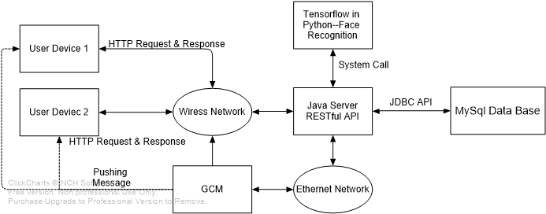
2. System Design - Overview
Overall Architecture

Slide 11
2. System design ANDROID application

Slide 12

2. System design – Android application
What is Android?
A mobile operating system
Developed by Google
Mainly deployed on portable devices
Smartphones
Tablets
Wearable devices

Slide 13
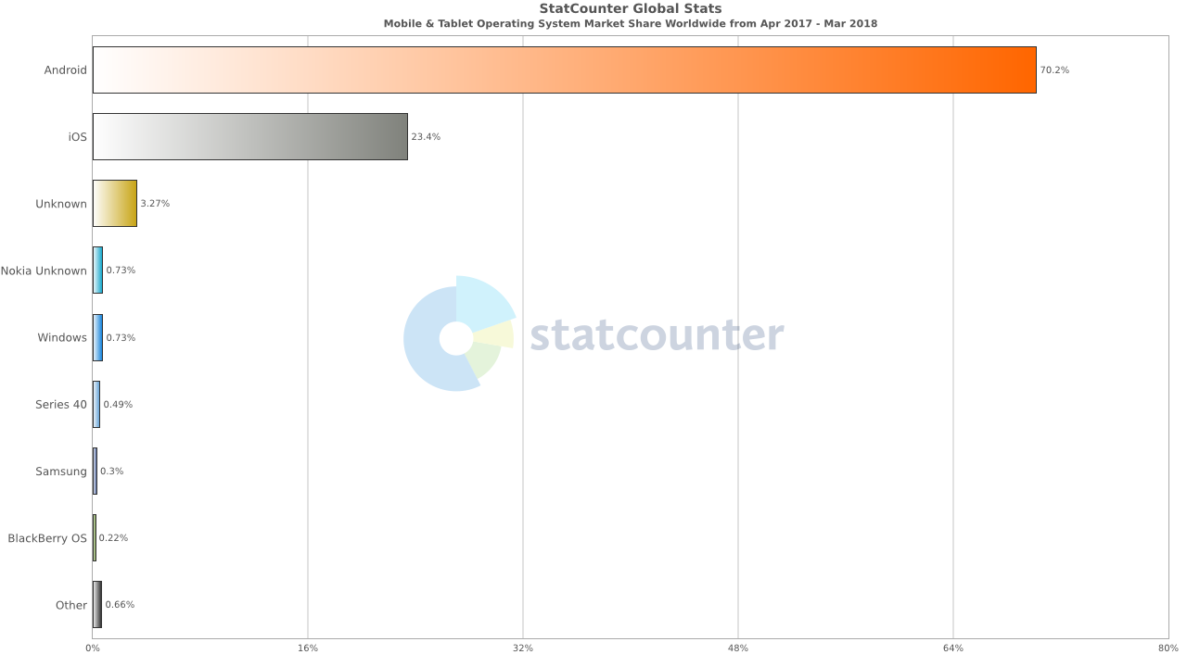
2. System design – Android application
Why Android?

Slide 14

2. System design – Android application
Development Environment for Android Application
Programming Environment
Windows 10
IDE
Android Studio Ver. 3.1.1
Simulation
Android smart phones (Ver. 5.1)
Virtual device is supported
Android Version Supported
Ver. 4.0 +

Slide 15
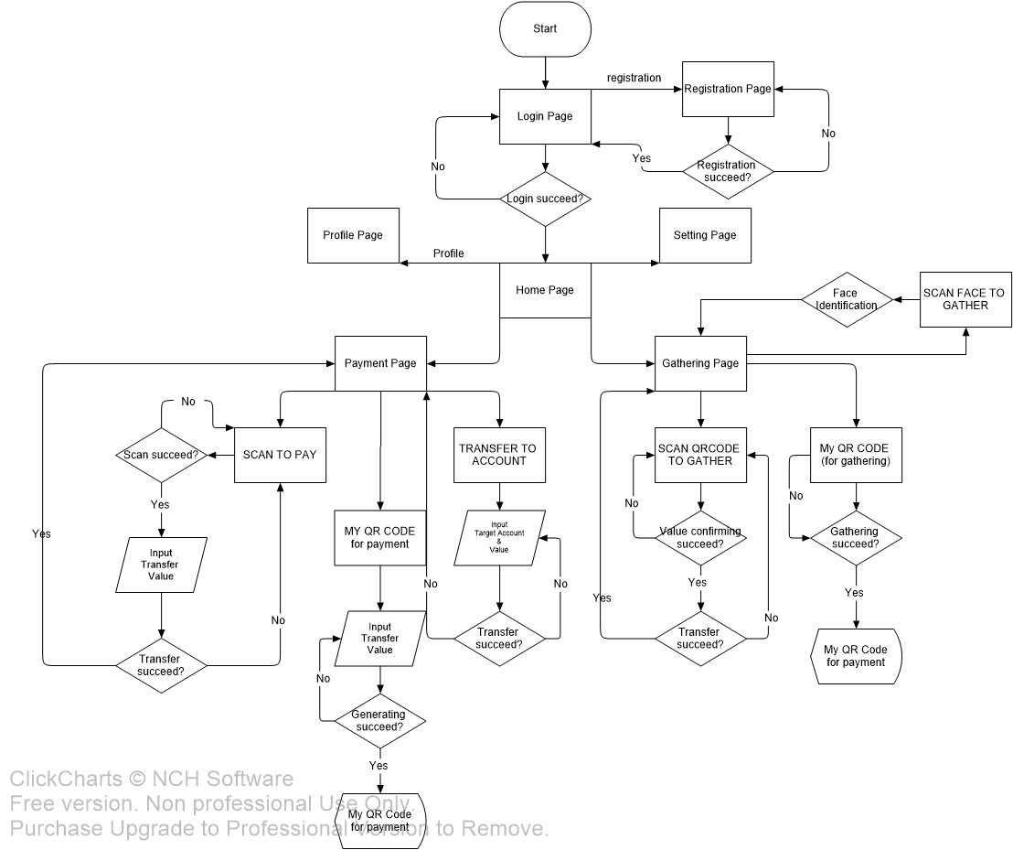
2. System design – Android application
Overall User Interface Flow Diagram

Slide 16
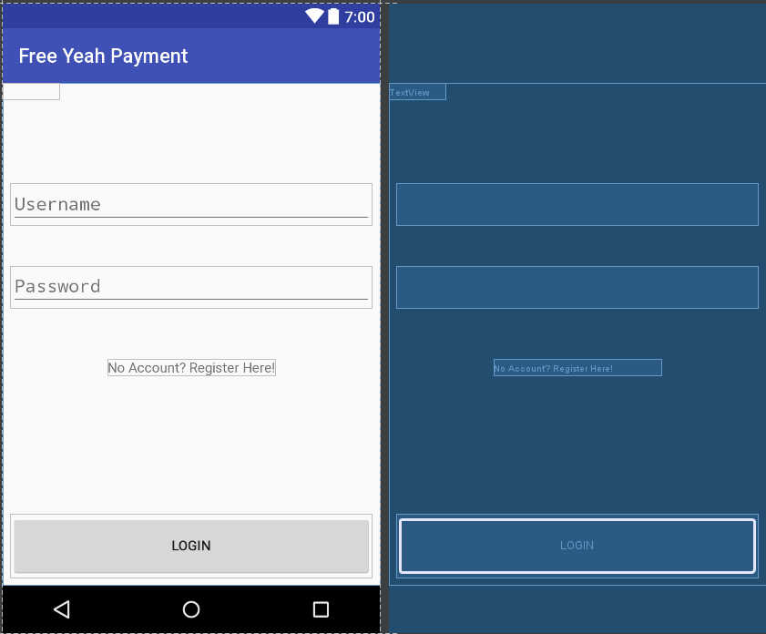
2. System design – Android application
Login Page
Enter the user name
Enter the password
Click the button to login
Click the text to register

Slide 17
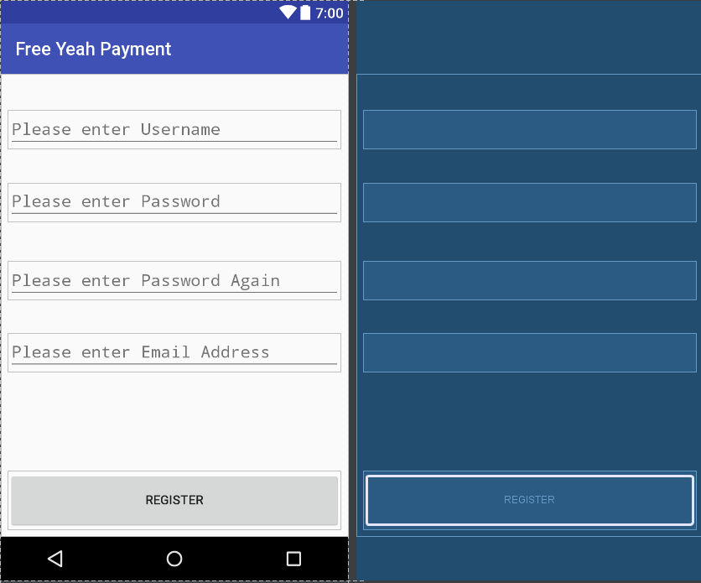
2. System design – Android application
Register Page
Enter the user name
Enter the password
Enter the email address
Click the button to register

Slide 18
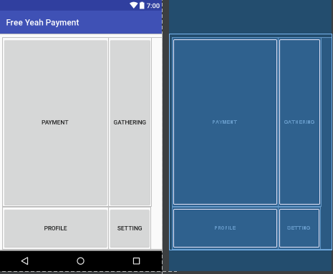
2. System design – Android application
Home Page
Pay money
Receive money

Slide 19
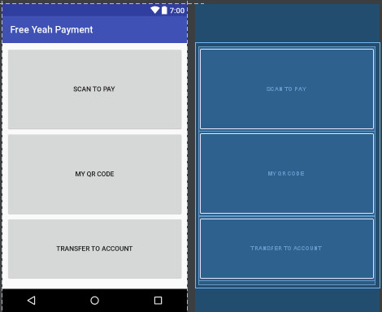
2. System design – Android application
Payment Page
Scan a QR Code
Generate a QR Code
Pay by account

Slide 20
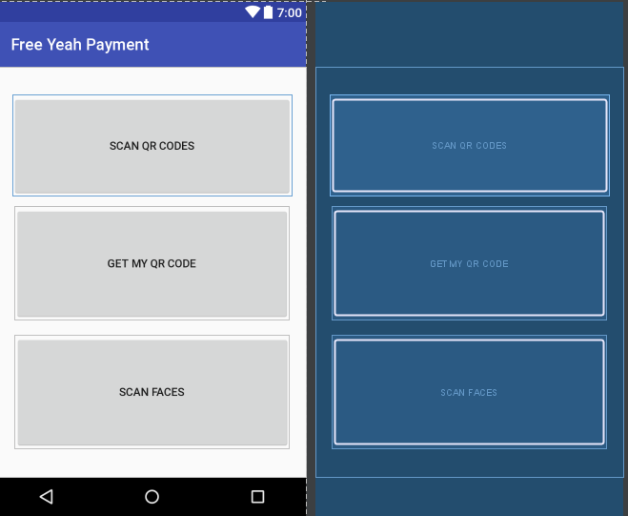
2. System design – Android application
Gathering Page
Scan a QR Code
Generate a QR Code
Scan a Face

Slide 21
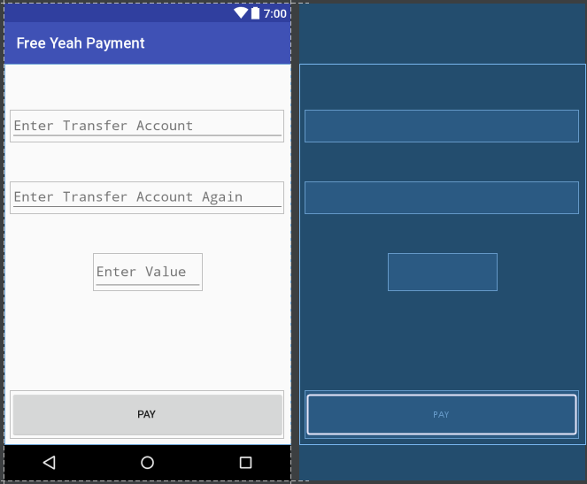
2. System design – Android application
Payment by Account
Enter the target account
Enter the target account again for check
Enter the transfer value

Slide 22
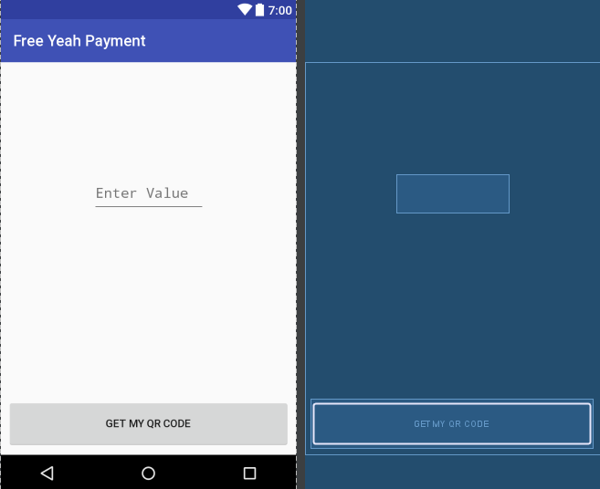
2. System design – Android application
Create a QR Code for Payment
Enter the Value for this Code
Click the button to create

Slide 23
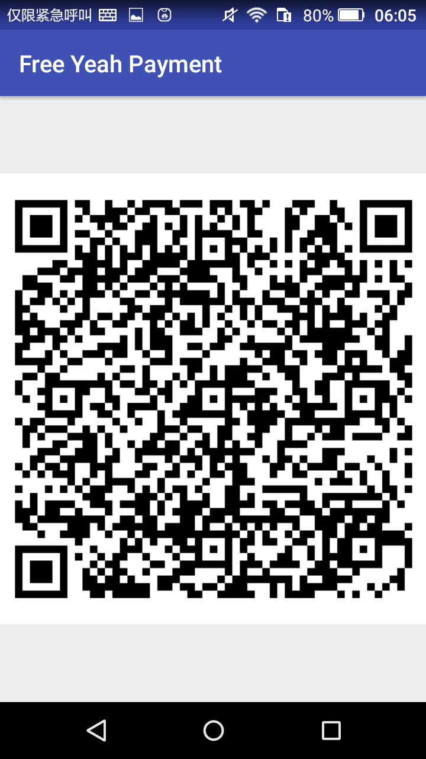
2. System design – Android application
Create a QR Code for Payment
The QR Code
Contain value inside

Slide 24
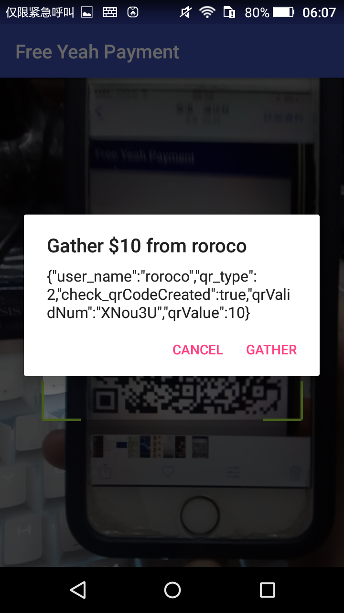
2. System design – Android application
Gathering by Scan a QR Code
Scan a QR Code
Check the target value
Display the payer account
Data in QR Code (only for demo here)

Slide 25
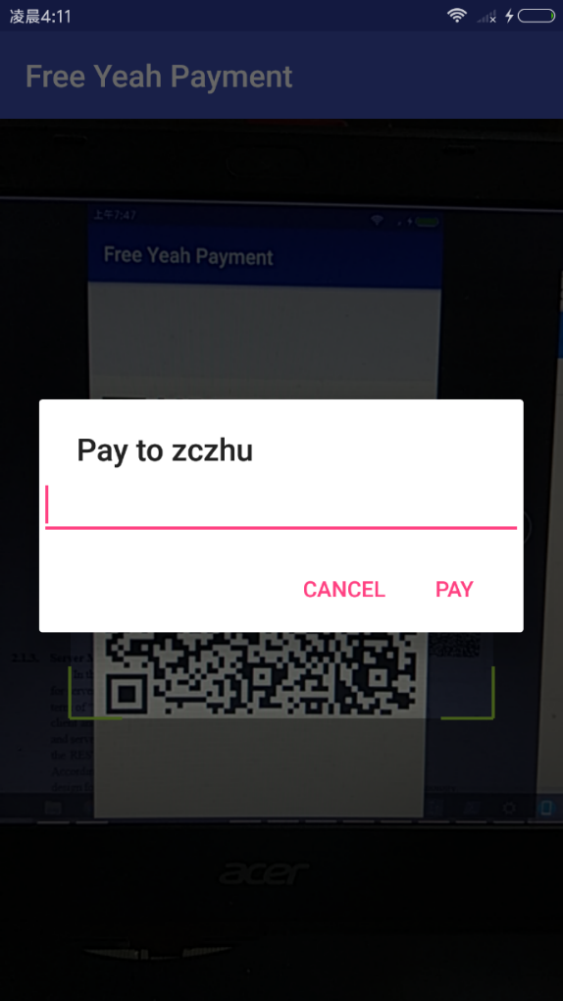
2. System design – Android application
Payment by Scanning a QR Code
Scan a QR Code
Check the target account
Enter the value
Confirm to pay

Slide 26
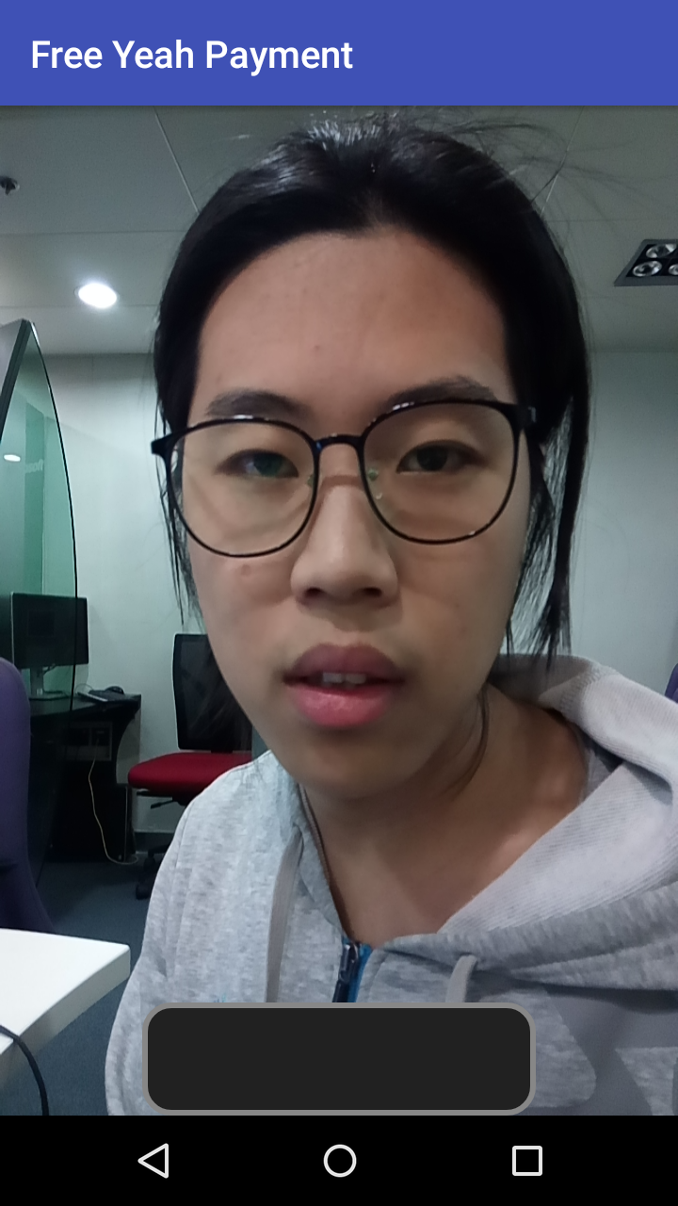
2. System design – Android application
Gathering by Scanning a Face
Scan a User’s Face
Click the bar to take the photo

Slide 27
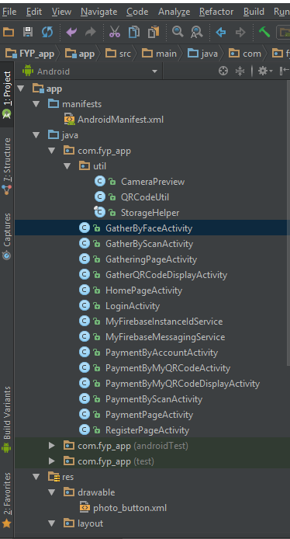
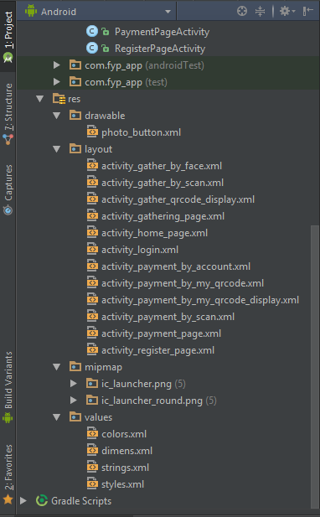
2. System design – Android application
Programming File Structure

Slide 28
2. System design – Android application
Communication Method with Server
HTTP GET Request
For most functions
HTTP POST Request
For uploading face images

Slide 29
2. System design server

Slide 30
2. System design – Server
Development Environment for Server
Programming Environment
Windows 10
IDE
Eclipse Ver. Mars.1 Release (4.5.1)
Project Management Tool
Maven
Java Version
Ver. 1.8.0_71

Slide 31
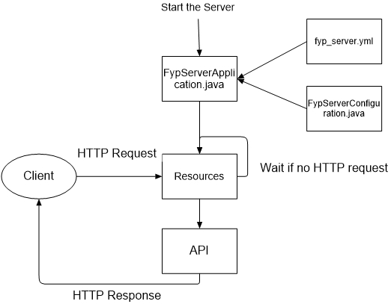
2. System Design – server
Working Flow of the Server

Slide 32
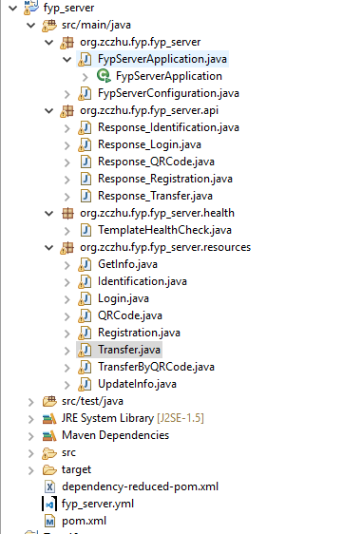
2. System design – Server
Programming File Structure
Server main application
API for response object
Resources
Server Port definition
Dependencies definition

Slide 33
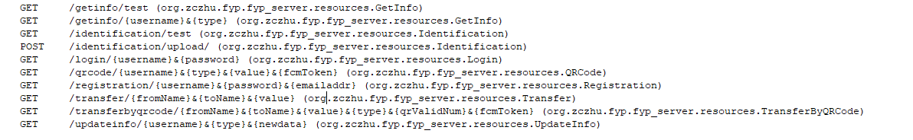
2. System design – Server
Supported URLs

Slide 34
2. System design – Server
Communication Method
With Database
Java DataBase Connectivity (JDBC) Library
With Android Application
HTTP Response
JSON format
Defined in API files

Slide 35
2. System design database

Slide 36
2. System design – database
Development Environment for Database
Environment
Windows 10
Tool
MySQL Ver. 5.7.19
Open source, free
Easy to use for individual user

Slide 37
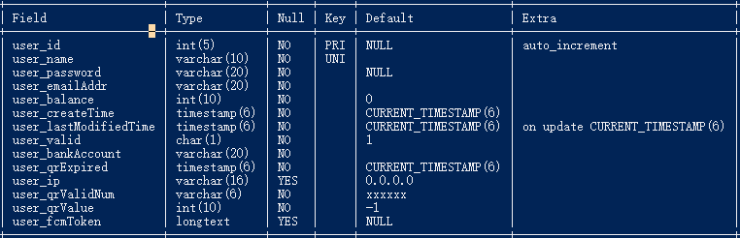
2. System design – Database
Table Structure
Table fyp_user

Slide 38
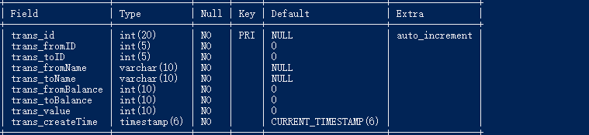
2. System design – Database
Table Structure
Table fyp_trans

Slide 39
3. Function design

Slide 40
3. Function design – Function list
Function Name | Description
Login | Users log in with necessary information
Registration | Users register with necessary information
Payment_byScan | Users scan a QR Code to pay. Transfer value input is required
Payment_byQRCode | Users generate a QR Code which can be scanned by others. Transfer value input is required before generating
Payment_byAccount | Users directly type in target and value to transfer
Gathering_byScan | Users scan a QR Code for gathering. Transfer value is defined in the QR Code
Gathering_byQRCode | Users generate a QR Code which can be scanned by others to transfer
GatherbyFace | Users scan a person’s face, who has already registered as a member and pre-upload the face images, and then the target user who has been scanned will receive a notification, which allows the target user to make the payment.
GCM notification | Users received notifications when transactions happened.

Slide 41
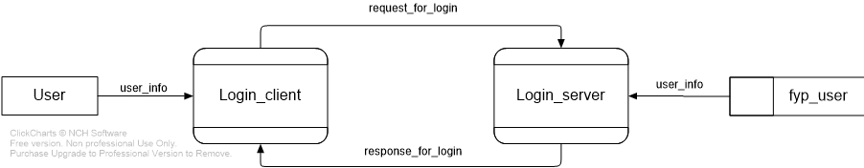
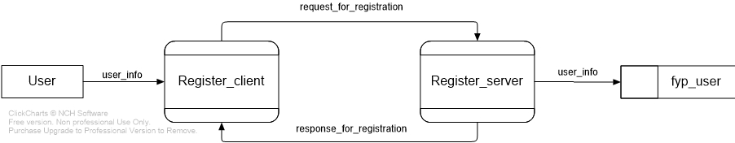
3. Function design – Working flow
Login
Register

Slide 42
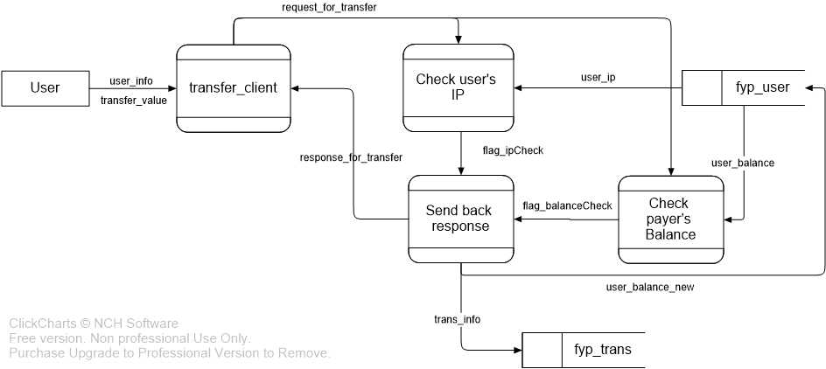
3. Function design – Working flow
Payment by Transfer

Slide 43
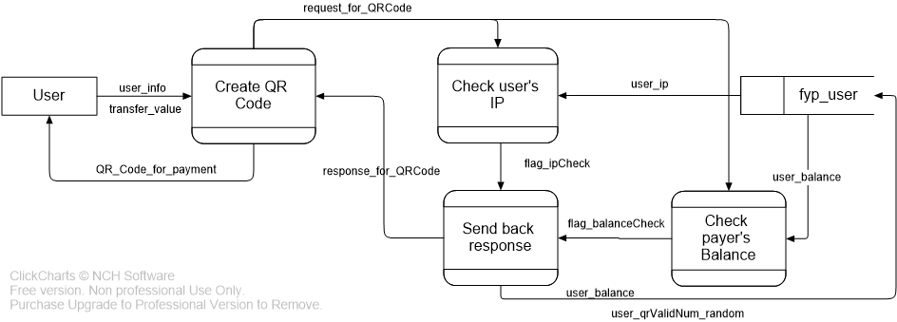
3. Function design – Working flow
Create a QR Code

Slide 44
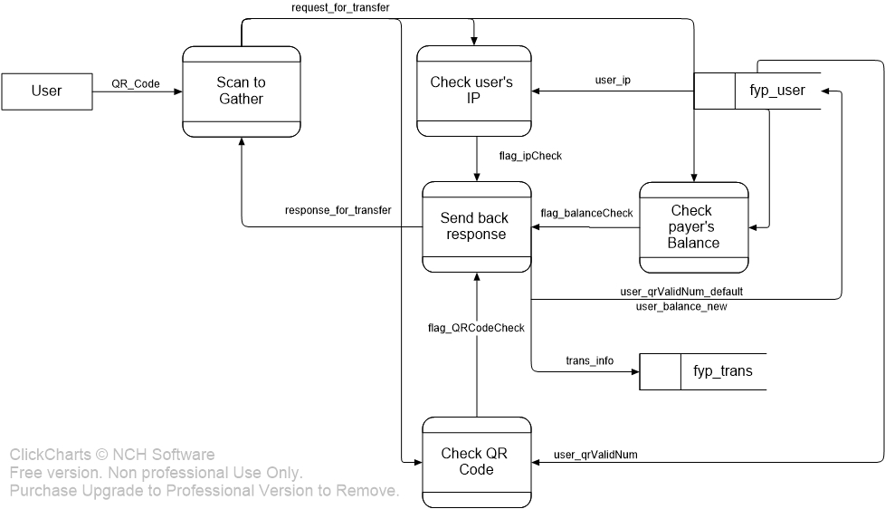
3. Function design – Working flow
Scan a QR Code

Slide 45
3. Function design PAY BY FACE

Slide 46
3. Function design – Pay by FACE
Pre-requirements
Google Play Service is on
Camera is supported and permitted
Target user has registered as a member
Target user has uploaded 10 images

Slide 47

3. Function design – Pay by FACE
Image Processing
Grayscale
Size [92*112]

Slide 48
3. Function design – Pay by FACE
Predication ID
Image Transfer
FYP SERVER
GCM SERVER
HTTP POST
HTTP POST
Encode by Base64
Notification
User Device

Slide 49
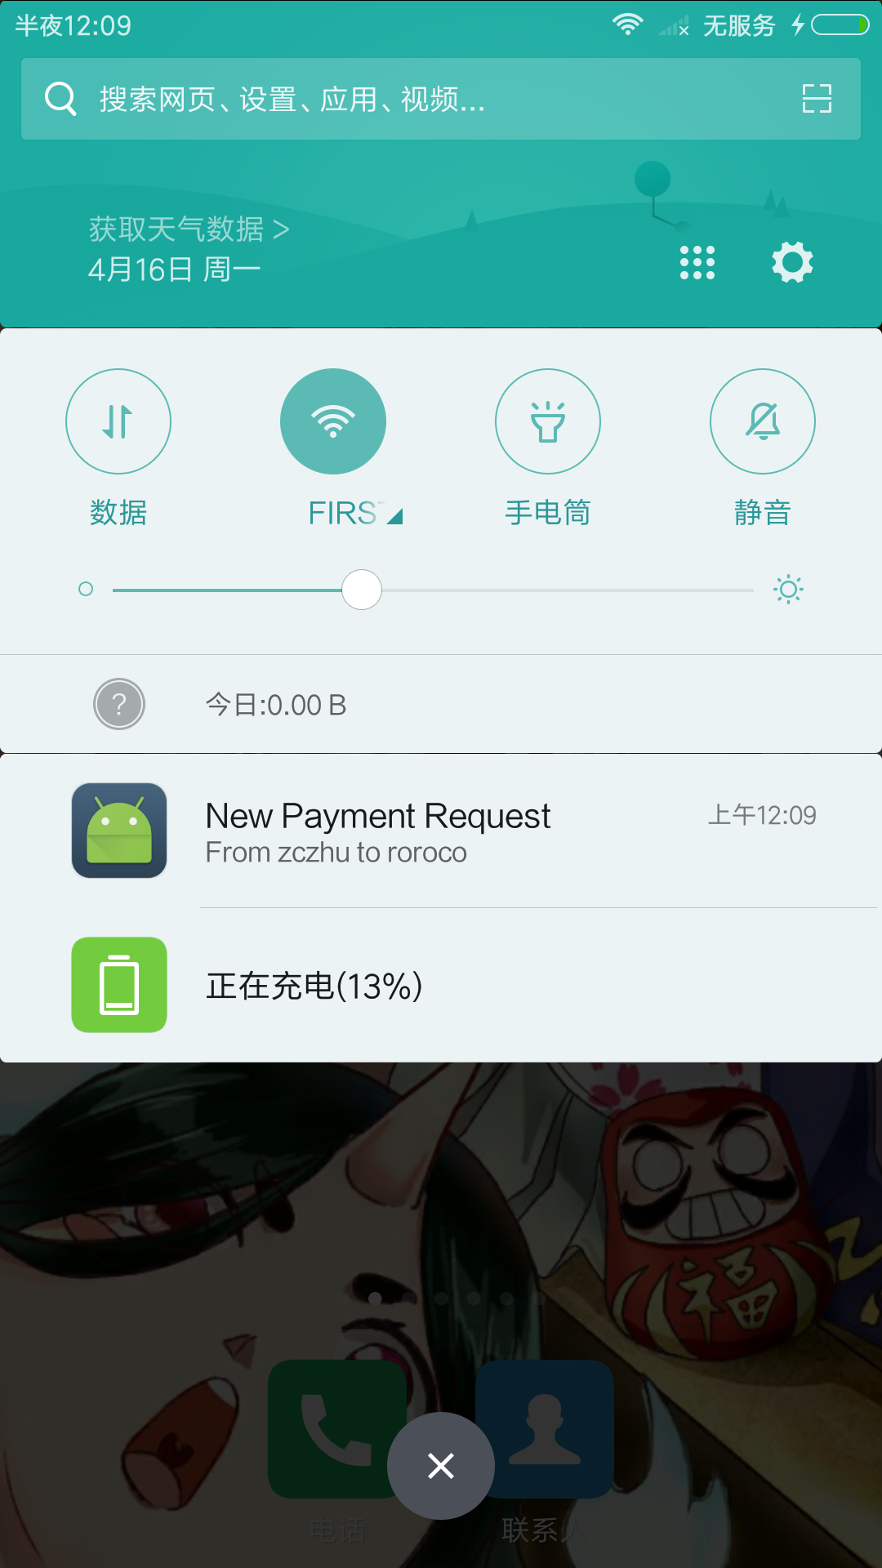
3. Function design – Pay by FACE
Target user receives a notification
Ignore the notification if incorrect
Click the notification to pay

Slide 50
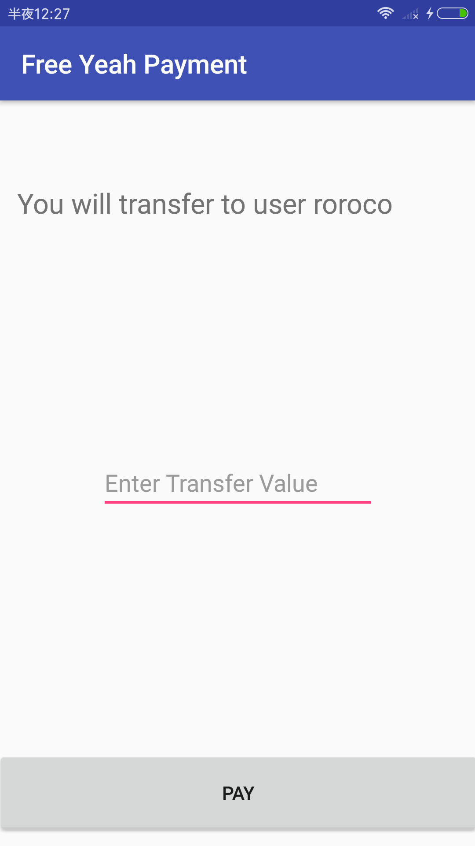
3. Function design – Pay by FACE
Specify the transfer user name
Enter the value
Click the button to pay

Slide 51
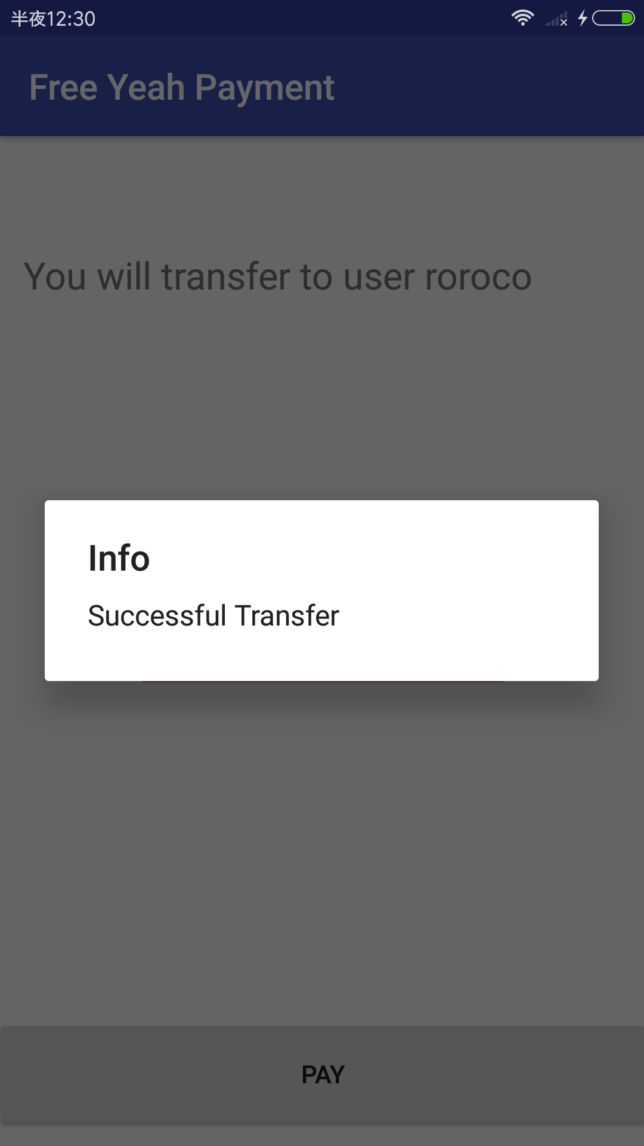
3. Function design – Pay by FACE
The dialog shows the transaction status

Slide 52
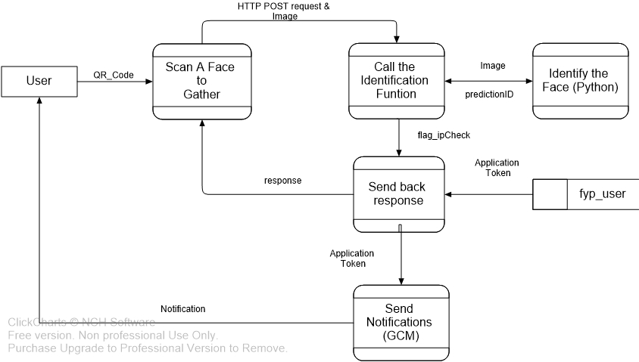
3. Function design – Working flow
Scan a Face

Slide 53

3. Function design – Pay by FACE
Identification Method
Eigenface – Principle Component Analysis
Ref. M. Turk and A. Pentland (1991). "Face recognition using eigenfaces" (PDF). Proc. IEEE Conference on Computer Vision and Pattern Recognition. Pp. 586–591.
Artificial Neural Network Approach
Construction Environment
Tensorflow
Deep Learning Tool developed by Google
Open source
Python 3.6

Slide 54
3. Function design – Pay by FACE
File Structure
model.py
Run to train & save the model
restore.py
Run to restore the saved model
And make the identification on images
/Models
Models and variables, graphs are stored
/FaceDatabase
All the users’ face images and images for identification are stored

Slide 55
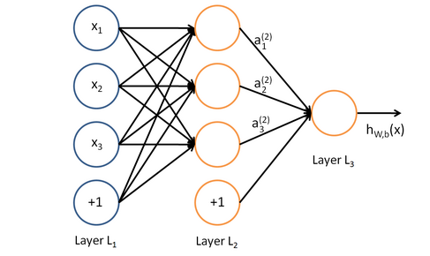
3. Function design – Pay by FACE
Neural Network Structure
2 Layers
Input layer & hidden layer
Input Nodes
determined by PCA
Hidden Nodes
determined by database size
Output Nodes
determined by number of users

Slide 56
3. Function design – Pay by FACE
Neural Network Structure
Active function for layers
Rectified Linear Unit (ReLU) function
Loss function
Softmax & cross-entropy
Optimizer
Gradient Descent Optimizer
Learning rate
Manually justify

Slide 57
3. Function design – Pay by FACE
Sample Test – Training Settings
10 people
10 images for each
60% for training & 40% for testing
50 hidden nodes
learning rate is 0.01
training literation number is 5000

Slide 58
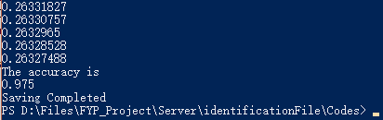
3. Function design – Pay by FACE
Sample Test – Training Result

Slide 59
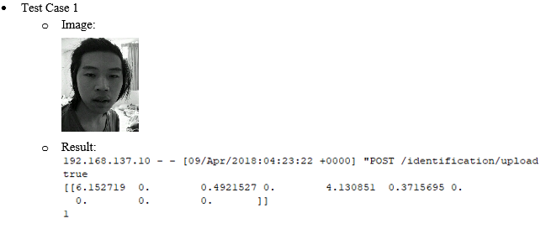
3. Function design – Pay by FACE
Sample Test – Identification Result

Slide 60
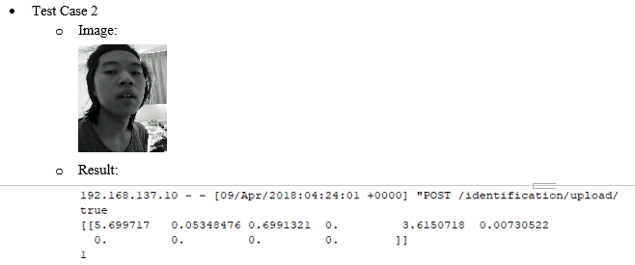
3. Function design – Pay by FACE
Sample Test – Identification Result

Slide 61
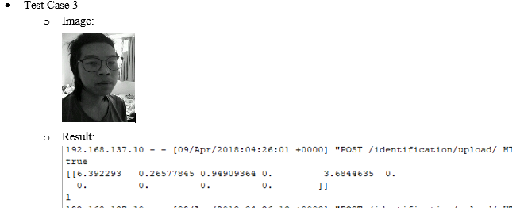
3. Function design – Pay by FACE
Sample Test – Identification Result

Slide 62
4. further improvements

Slide 63
4. Further improvement
Security
URL Security
QR Code Security
Face Identification
Capacity of the Model
Processing the Failed Identification
Retraining of the Model

Slide 64
5. Conclusions

Slide 65
5. Conclusions
The whole system was completely implemented
Multiple payment methods are supported
Still many challenges on applying face identification to real-life electronic payment system

Slide 66
6. q & a

